Slide 1
Study Skills
Tips for Being Successful in School and in Life

Slide 2
Step 1
Attitudes and Goals

Slide 3
7,258

Slide 4
Set Goals
Set short term goals for each trimester
Goals don’t always have to be academic
Social
Personal
Physical
Etc
Example:
Turn in all homework
Make two new friends
Run one mile in under 8 minutes

Slide 5
8,607

Slide 6
Maintain Your Environment
Make sure you study in a place free from distraction
Should be quiet and organized
Only instrumental music, if any
Lyrics actually divide your attention- your sub-conscious is listening to the words to the song
Your study environment should be as similar as possible to your testing environment
Arrange time each day to study (if needed)

Slide 7
8,607

Slide 8
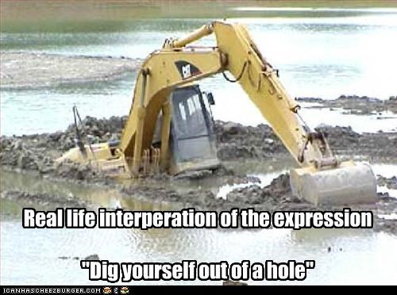
Time Management
Make a time schedule and try to stick to it
Complete tasks in order of importance…and remember they can change
Try to start out on the right foot
It is much easier to “adjust” at the beginning of the trimester than to dig yourself out of a hole at the end

Slide 9
8,607

Slide 10
Think Rationally
NEVER SAY, “There is plenty of time to do this”
If you do, you are procrastinating
Develop a positive attitude toward school work
You learn better when you enjoy what you are learning
Think of school work as helping you achieve long term goals
Try to apply information to something you enjoy

Slide 11
8,607

Slide 12
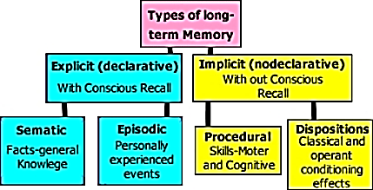
Study Techniques
Proven Ways to Commit Information to Long Term Memory

Slide 13
8,607

Slide 14
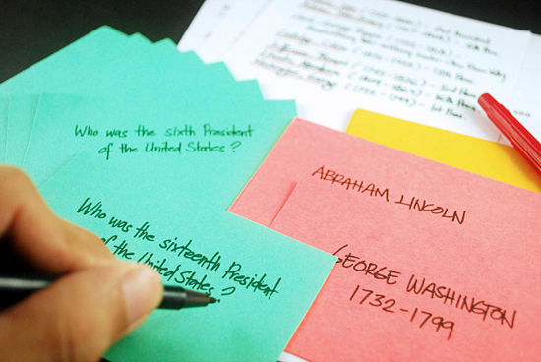
Index Card Stacking
Write out ALL information you need for a test onto index cards
After you have written them out, take the first three and memorize them going BOTH WAYS (ex- vocab word to definition, then definition to vocab word)
Once you have those 3 down, set them aside and do the same with the next 3
Once you have those 3 down, pick up the original three and go over all 6
Once you have all 6 down, pick up another three and memorize those
Then add the first 6 and go over all 9….continue until you have gone through entire stack

Slide 15
8,607

Slide 16
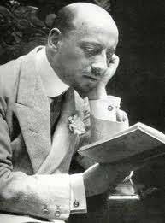
SQR Method
Prior to each section:
1. Survey the section
Look at vocabulary, chapter introduction, pictures, titles of sub-sections, etc
Get an idea of what the section is about
2. Question
Try to pick out what types of things might be questions on the test
There is usually at least one question from each sub-section
What are the most important things in the section?
3. Review
After we go over the section in class, review it at home with your notes
Look to see what was gone over in class and pulled out as most important

Slide 17
8,607

Slide 18
Overlearn
Especially in MATH and SCIENCE
It is okay to practice a concept, even when you don’t have an assignment or you have finished it
The keys to math and science are to memorize a process, if you don’t have it down after doing just the “odds”, do the “evens” too

Slide 19
8,607

Slide 20
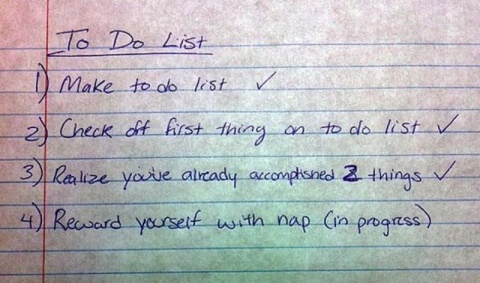
Test Prep Check List
Did you…
Review notes daily
Read material prior to being covered in class
Ask for help (if needed)
Actively participate in class
Complete all homework thoroughly
Avoid a last minute cram session
Sleep at least 8 hours the night before
Eat a good dinner and breakfast before test day

Slide 21
8,607

Slide 22
Organization
Where do you write down what you need to complete for homework?
Planner
Calendar
“Alarmed” app
Moodle and QR Codes are meant to be “fall back” sources in case you forget
They will not always be there- high school
Get into good habits now
Where do you place your homework when it is completed?
Homework Folder
Subject folder
It SHOULD NOT GO: in a textbook, loosely into your backpack, into the wrong folder

Slide 24
Get my point?
What was the FIRST number I showed you at the beginning of this lesson?
7258
What was the other number I showed you repeatedly?
8607

