Slide 1
Introduction
Agree or Disagree
History repeats itself.
When people repeatedly view violence in different forms of entertainment, they become hardened to it and are not upset by it.
Playing violent video games and watching television programs or movies with extreme violence is just a leisure activity and not something that can desensitize people to violence.
We glorify violence in our country.
Societies that glorify violence and accept it as a form of entertainment are barbaric and uneducated.
Violence begets violence, and if you watch it you will want to behave in a similar manner

Slide 2
Fall of Rome
Why did Rome cease to exist as a civilization?

Slide 3
Fall of the Roman Empire
Rome was the most powerful empire the world had ever seen.
It is remembered for its many accomplishments
By the 4th century AD the Empire had some serious problems

Slide 4
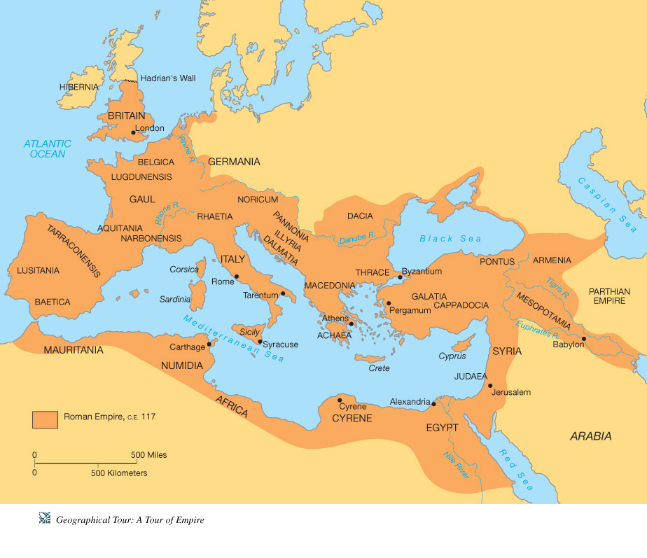
Roman Empire at its height 117 C.E.

Slide 5
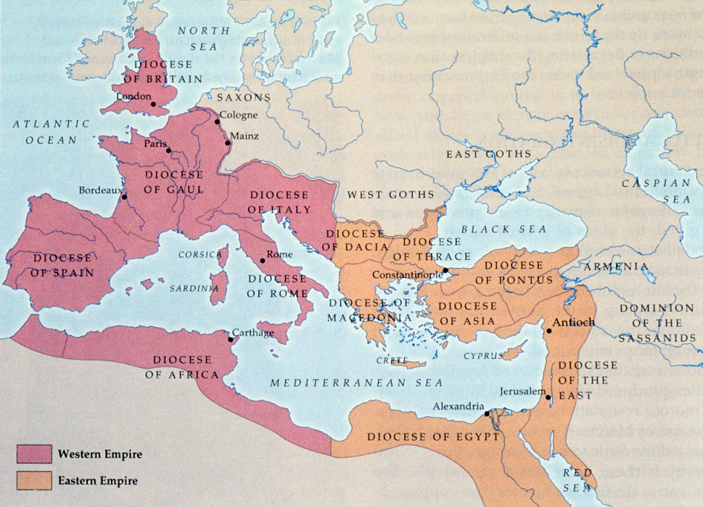
The Spilt of the Empire. -The Roman Empire had become too large to control -395 AD it is split into two separate empires

Slide 6
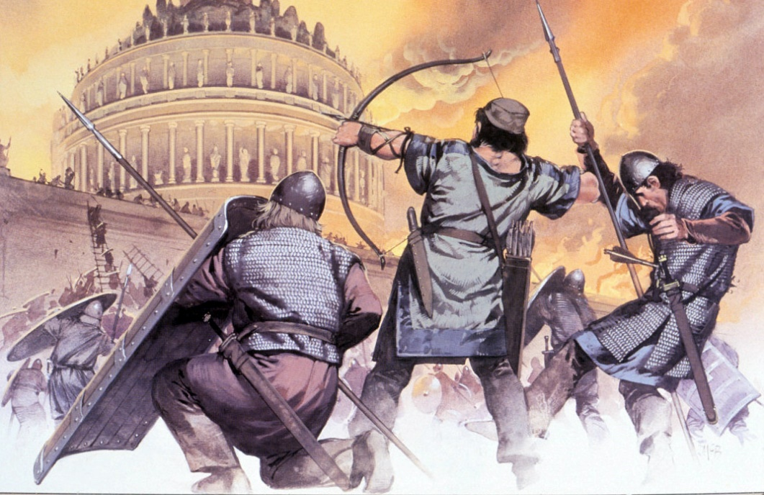
Murder?
Pressure from Parthians in the east (modern-day Iraq and Iran)
Pressure from barbarians along the Rhine and the Danube (Germany)
Increasing military sophistication of barbarians as a result of contact with Roman armies

Slide 7
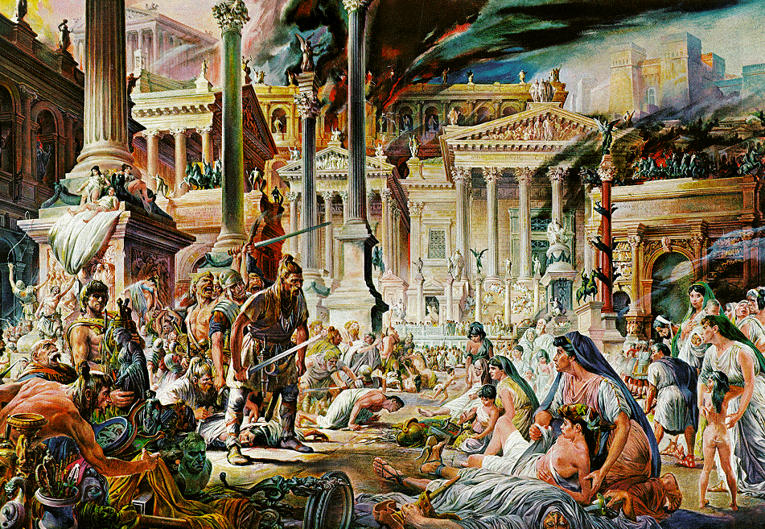
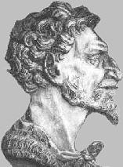
Murder? (Barbarians fault)
4) Sack of Rome by Alaric the Visigoth, 410
Invasion under Attila the Hun, 455
Overthrow of emperor Romulus Augustulus by barbarian mercenaries under Odacer the German, 476
Attila The Hun

Slide 8
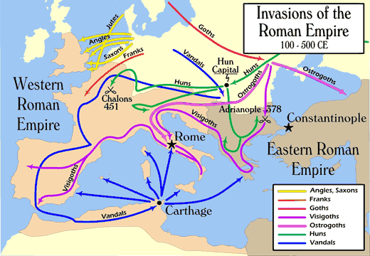

Slide 9
Suicide? (Romans fault)
1) Increasing dependence on barbarian mercenary troops
2) Overextended borders,
3) Over-dependence on slave labor
Conflict between traditional Greco-Roman religion and a spreading Christianity introduced from the east
Loss of Morality? Violent Culture

Slide 10
Old Age? (It was just their time)
General wear and tear of long-term imperial administration and defense
Increasingly rigid social class structure and declining opportunities for advancement
Exhaustion resulting from ever-increasing taxes
Abandonment of traditional Greco-Roman religion for Christianity; people place their hopes in life after death.

Slide 11
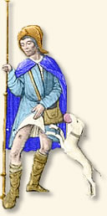
Inevitable?
Plague of 165-66 CE kills a half the Roman empire’s population
Roman mines run out of gold and silver, starting in 160s; Roman emperors forced to cut gold and silver content of Roman coinage
Declining value of Roman coinage forces ruinous inflation. Roman currency almost useless as a medium of trade by 280s CE
Rome collapses into a barter economy by 280s CE

Slide 12
The Western Empire Falls
476 AD Rome falls to the barbarians never to regain power.
The Eastern Empire at Constantinople would continue to survive for almost 1000 years.
The Eastern Empire called the Byzantine Empire.

Slide 13
Pondering…
What type of violence-based leisure activities do Americans participate in and/or support?
What does our support of these types of activities say about our country's attitude toward violence?
In ancient Rome, the death penalty was common for criminals, prisoners of war, and for people in positions of power. In what ways does our society mirror the ancient Romans when it comes to these three areas? How is our society different?
Murder was common in ancient Rome, regardless of social class. Do you think the same could be said about American society? Why or why not?
Roman entertainment often centered around violence, such as the gladiator games. In what ways does American entertainment also center around violence?

Slide 14
What can we learn?
Many lessons can be learned from the behavior of the ancient Romans. While few except the scholars and writers of the time seemed opposed to the level of violence in ancient Rome, it was ultimately a contributing factor in the downfall of the Roman Empire. Examine American culture and the way people in the U.S. view violence against one another. Do you think the American glorification of violence will contribute to its downfall?

Slide 15
Choose a central topic such as:
The death penalty
The sale of violent video games
The sale of violent music
Violent television programming (including certain sporting events)
The violent crime rate in the U.S.
The American prison system
Violence in U.S. schools
Create a presentation (PowerPoint or Prezi) that examines the similarities and differences between American attitudes about this type of violence and what the Roman attitude may have been. Answer the following questions:
In what ways do the two societies seem to share a common belief?
How do the two societies differ when it comes to these topics?
How do you think American society will be affected in the long term by the violence that is part of our daily lives?
What can be done to prevent violence from causing the downfall of America, or is this even a possibility?
Illustrate your opinions and support them with as many specific reasons, facts, and examples as you can provide.

