Slide 1
Resumes
The Slippery Slope

Slide 2
What is a resumé?
A resume is a document used by job seekers that outlines their background, qualifications, and skill sets
When you apply for a job, you are asked to hand in a resume
Resumes are often the first impression that your employer gets of you
It is important to create a resume that gets to the point, is neat, and shows why you should be considered for a job

Slide 3
Don’t try to be funny…and don’t be on accident
Application: How large was the department you worked in with your last company? “A: 3 stories.” (Resumania)
A resume listed a skill as “being bi-lingual in three languages” (Ask Annie’s)
Background: “28 dog years of experience in sales (four human).” (Resumania) In the section that read “Emergency Contact Number” she wrote “911.” (Ask Annie’s)
Candidate drew a picture of a car on the outside of the envelope and said it was the hiring manager’s gift. (Careerbuilder.com)
Languages: “Fluent in English. Also I have been heard muttering Gibberish in my sleep.” (Resumania)
“Directed $25 million anal shipping and receiving operations.” (ResumePower.com)
“One candidate included clipart on their resume of two cartoons shaking hands.” (Ask Annie’s)

Slide 4
The Hard Truth
Employers spend an average of 15 seconds per resume.
On the average, employers grant one interview per 245 resumes.
Some companies receive over 100,000 resumes a year.
Employers receive between 10-200 resumes per newspaper want-ad.
Between 85-95% of all resumes end up in the trash.

Slide 5
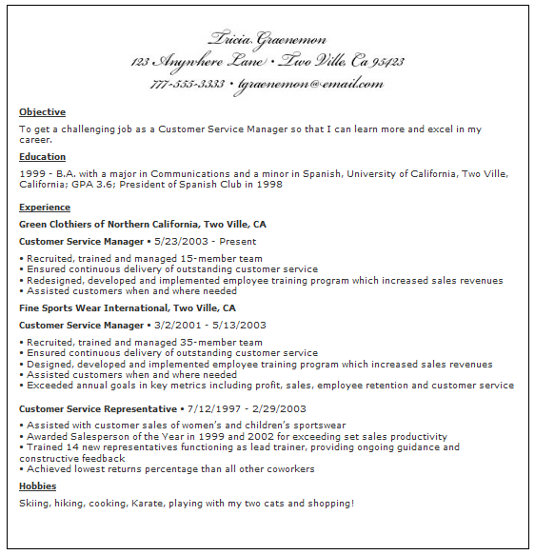

Slide 6
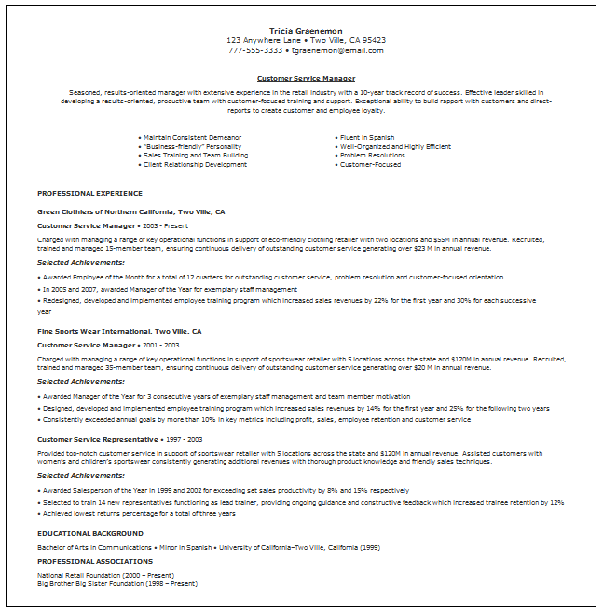

Slide 7
How to write a resume:
Section 1: Heading- create a clean heading with your name, address, phone number, and email address
Example: Justin Weise
123 Sesame Street, Jacksonville, FL 32216
(555)-720-0398
justinweise@hendricksdayschool.org

Slide 8
How to write a resume:
Section 2: Skills- list, in bullet form, any skills that you have that are not reflected in your education or work experience.
Example:
Proficient in Microsoft PowerPoint, Word, and Excel
Maintains positive report with colleagues and students
Ability to defeat ligers with eyes closed and hands tied behind back

Slide 9
How to write a resume:
Section 3: Experience- list any professional experience you’ve had. As an adult, this will be jobs during and after college. As a teenager/young adult, it will be jobs, babysitting, or other positions of responsibility you have held. First, in bold, the position held with dates. Underneath, the place of employment. Then, bullet your major responsibilities and accomplishments in that position.
Example: Educator- Social Studies 2009-present
Hendricks Day School Jacksonville, FL
Taught courses in US History, World Geography, and World History
Coached baseball and sponsored Student Council
Held position on Strategic Planning Committee

Slide 10
How to write a resume:
Section 4: Education- Here you will list your degrees, diplomas, etc. As an adult, this will be all college degrees, as a teenager, you will list to what level you have currently completed. First your level of completion. Then underneath, the school and date of graduation.
Example: Bachelor of Arts History with minor in Education
University of Florida, 2006

Slide 11
How to write a resume:
Section 5: Awards and Accomplishment (optional)- list, in bullet form, any awards or accomplishments in your education or work experience
Example :
2007 Teacher of the Year Award
Doctors Charter School of Miami Shores

