Slide 1
Money Skills
Part 1: Budgeting

Slide 2
Budgeting
Why is budgeting important?
What are expenditures?
entertainment
clothing
electronic equipment / games / mobile (cell) phone costs
recreation
transport
hobbies
food
charity/non-profit donations

Slide 3
Budgeting?
How does your budget change during the year?
Christmas/Hanukkah?
Birthdays?
Report Cards?
Graduations?
It is important to remember that BUDGETS CAN CHANGE!

Slide 4
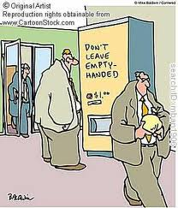
What is an impulse purchase?

Slide 5
Budgeting Practice
Get out a pencil
Write down a list of your monthly expenditures
How much money do you get in a month?
Write how much you want to allot to each expenditure
Example:
I get $20/week as an allowance
I want to purchase the following things: Movie ticket, new sweater, two posters of Josh Hutcherson for my bedroom wall
Cost: Movie ticket ($10), Movie posters ($16), Sweater ($40)….total: $66
I will have $14 left over at the end of the month
I can buy the movie and 1 poster this week, the sweater the 3rd week, and the other poster the last week of the month

Slide 6
Money Skills
Part 2: Saving

Slide 7
Savings
Why should a middle school student save money?
What would happen if you saved 1/3 of your income?
What if you put that into a savings account that generated interest?
http://www.moneychimp.com/calculator/compound_interest_calculator.htm

Slide 8
Savings
What are some larger purchases someone might use a credit card to purchase?
Write down what you think a cost for one of those items is.
Timetable- when do you need to have it?
Set a goal and plan! Write down how much you need to set aside per month to purchase your item by your target date
This money should come outside of normal savings
In other words, you will need to cut something else besides savings out

Slide 9
Saving Practice
Think of something that you want to purchase at some point in the future
Create a saving plan for your future purchase

Slide 10
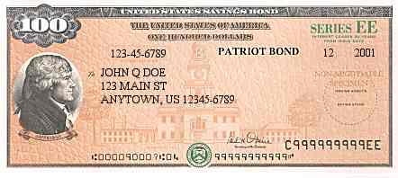
Savings Bonds
What are savings bonds?
When you purchase a savings bond from the government, you are basically loaning the gov’t money that they will pay back at a later date + interest
Minimum Purchase: $25
Maximum Purchase: $30,000 per person per year
Interest: 90% of 6-month average of 5-year Treasury security yields, added monthly and paid when the bond is cashed
Minimum Term Of Ownership: 12 months
Early Redemption Penalty: Forfeit three most recent months' if cashed before 5 years
Example: most EE Paper bonds are purchased for 50% of face value, then redeemed for face value at the set date

Slide 11
Section 2
Credit

Slide 12
What is credit?
Credit is when a company loans you money or gives you a spending limit for which you promise to pay them back PLUS interest.
Is credit a good thing or a bad thing?
Bad- credit can be very dangerous. Having a credit card in your pocket with a 10,000 spending limit on it can be very tempting.
Good- it is essential be responsible with your credit. How companies view your credit history (paying your credit bills) will determine whether you can buy a house, a car, or even get electricity turned on in your house!

Slide 13
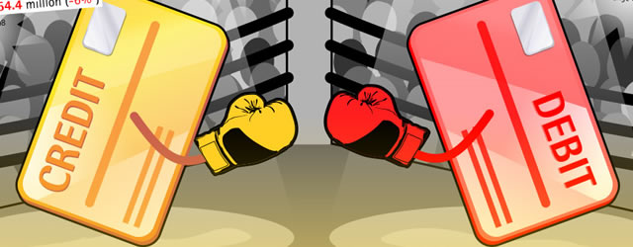
Credit Card vs. Debit Card
A credit card has a maximum amount that the credit card company will allow you to spend for which you have to PAY BACK + INTEREST
A debit card SUBTRACT THE MONEY YOU ALREADY HAVE from your bank account or pre-paid account

Slide 14
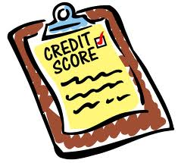
What is a credit score?
Your credit score is your financial fingerprint
Credit scores are like the SAT’s of the financial world
Perfect score- 850
Lowest score- 300
Average score- 689
Most companies will not loan to a person with a credit score lower than 580 no matter what (15% of the country)
Good credit is considered 700 or above

Slide 15
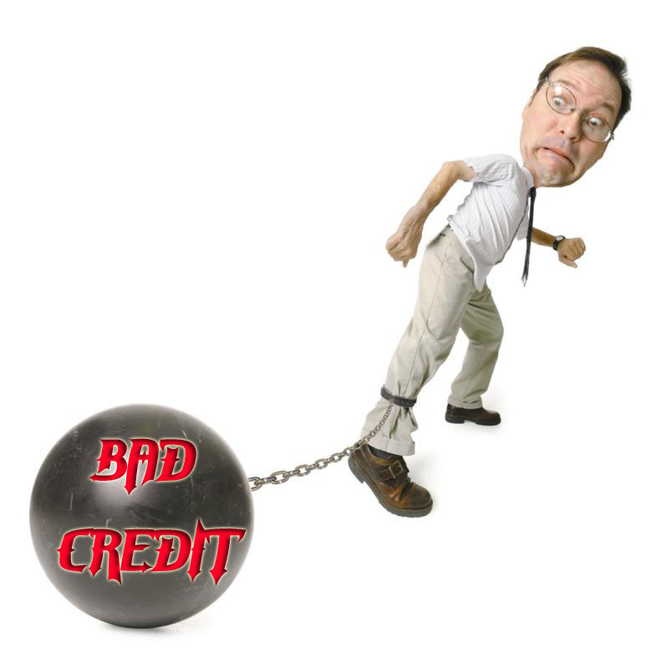

Slide 16
How is credit scored?
35%: Payment history- Late payments on bills. Bills paid on time will improve a credit score.
30%: Credit utilization- The amount of money being used out of the total amount of money available. You should always try to keep your total credit usage below 50% of credit available.
15%: Length of credit history- As a credit history ages it can have a positive impact on its FICO score.
10%: Types of credit used- diversity = good
10%: Recent searches for credit—Credit inquiries, which occur when consumers are seeking new credit, can hurt scores. Searches are grouped to count as 1 search- ex: multiple car loan applications. If you search your own credit score, it doesn’t count.

Slide 17
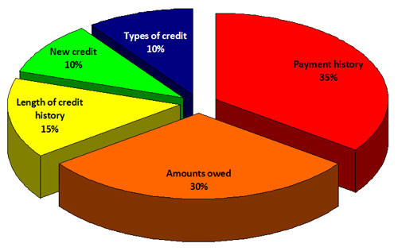

Slide 18
What types of credit are there?
Installment Credit- you receive a loan and agree to pay a set amount per month for a set time frame
Ex: mortgage, car loan, student loan, personal loan, etc
Revolving Credit- you can borrow up to a certain amount per month and may choose to pay it in full or only a portion until it is paid off
Ex: credit cards
Open Credit- requires all money borrows is paid in full every month
Ex: business charge cards, paycheck advances, etc

Slide 19
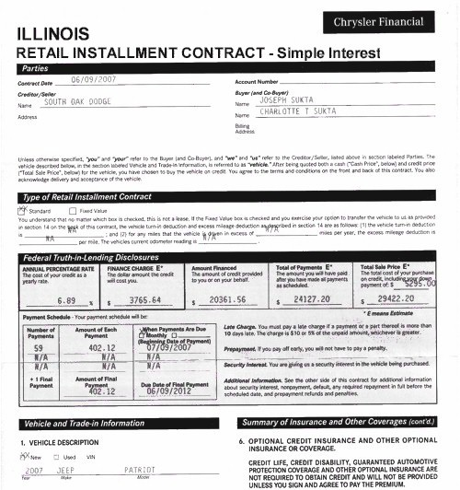
Installment Account

Slide 20
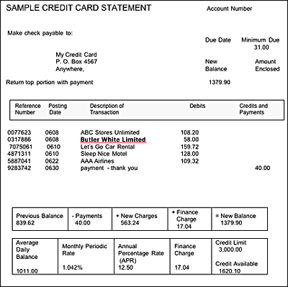
Revolving Account

Slide 21
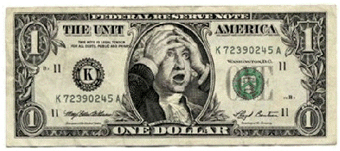
Why is it so dangerous?
Interest!
Interest rates can vary- the average APR for a credit card is 28%
Therefore, the more you rack up, the more you owe
Danger gets extreme when the interest added every month exceeds what you are able to pay

Slide 22
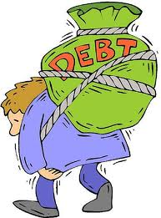
Why is it so dangerous?
$2.4 trillion- total debt of US consumers- $7,800 per person
1/3 is revolving debt
The average person with a credit file owes $16,500 excluding mortgages
$6,500- average credit card debt projection per person by the end of the year
1 in 10 consumers has more than 10 credit cards- 4 is average
1 in 50 households has over $20,000 in credit card debt
1 in 21 credit card holders are 60 days or later in their payments
In the past 20 years, total American debt has increased 258%

Slide 23
Whaddyado?
What do you do if you are a senior in high school and your parents lose their jobs right before you apply for college and they have not saved for your education?
Scholarships!
Grants!
Avoid loans at all costs!!!

Slide 24
Student Loan Horror Story
Joseph Orsolini, CFP, College Aid Planners, Inc. “I am working with a young lady who recently graduated from an elite college with $172,000 of student loan debt. She is going to law school in January and will add another $100,000 on to that total...some people never learn! We got her loan payment down to $1,200 per month by having her go back to school at her local community college so she could continue deferral on some of her loans. It was cheaper to pay that tuition than her student loans…I would never have let [her] get in this deep.”

Slide 25
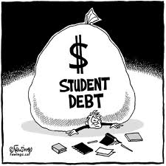
Loans
Student Loans
Your total loan should not be more than what you expect to make in your first year

Slide 26
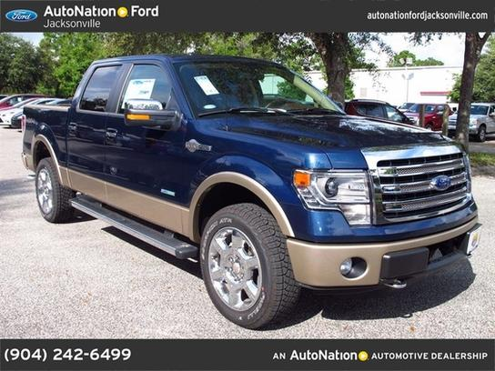
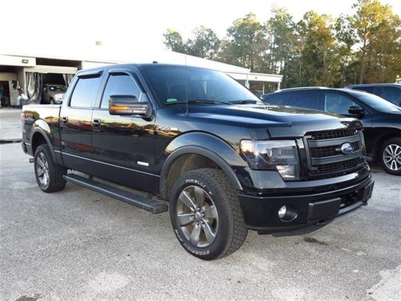

Slide 27
Buying a car in a few years?
Rule #1- Buy Used
Rule #2- Drive it as long as you can
When you buy a new car, its value drops by about 20% the second you leave the lot
Example:
2013 Ford F-150 FX4- New- $53,000
2013 Ford F-150 FX4- Used (15k miles)- $36,ooo

Slide 28
Buying a car in a few years?
20/4/10 rule
20% down payment
Loan for no more than 4 years (48 months)
10% of your income or less
How much will a car really cost per month including everything?
Double the price tag and divide by 60

Slide 29
Credit Cards
DANGER!!!
Conundrum- you want to avoid debt, but you want to build your credit score?
What the best practice?
Pay off what you owe each month
If not, pay it off within three months without adding more debt

Slide 30
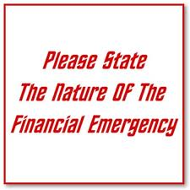
EMERGENCY!
What if something happens and your income drops or goes away completely?
Save for an emergency fund
Set a goal and plan

Slide 31
Retirement
What is retirement?
10% for basics, 15% for comfort, 20% to escape
Don’t touch it

