Slide 1
The Spread of Greek Culture
Section 3

Slide 2
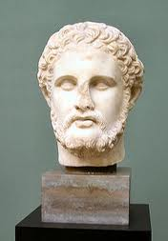
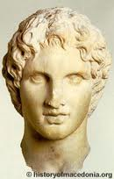
Intro
King Philip of Macedonia- had
Aristotle tutor his son (Alexander) in Greek teachings
Though of himself as Greek, spoke Greek
Greeks didn’t accept Macedonians as Greek- thought they were barbarians (wild, uncivilized people)
Alexander’s role model- Achilles

Slide 3
Philip Comes to Power
Philip had Greek ancestors- had studied in Greece
Dreamed of using diplomacy and force to conquer Greek city-states
United Macedonia in 359bc- formed alliances with some Greek city-states by bribes or threat
Built an army stronger than Sparta’s- took one city-state after another
Demosthenes- master of elocution (public speaking)- tried to warn Athenians of Macedonians (see pg. 217)
338 bc- Athens united to Thebes to try to stop Philip- lost

Slide 4
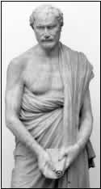
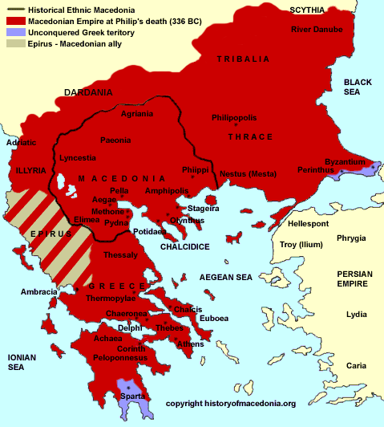
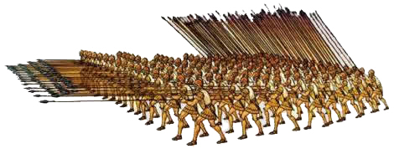

Slide 5
Alexander Builds an Empire
Philip was assasinated (murder for political reasons) before he could conquer Persia- 336bc
Alexander became king at 20
Alexander’s Conquests
1st action- invade Persia- much weaker than it was, but still huge- Egypt to India
Began in 334bc- marched through Persia
Eventually reached India
Became known as Alexander the Great
Named many cities after himself
Died in 323bc of fever on his return to Macedonia (33 years old)

Slide 6
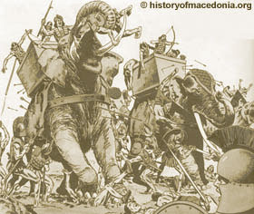
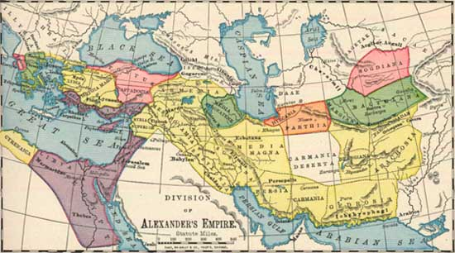

Slide 7
Greek Culture Spreads
After Alexander died, his kingdoms split into 3 parts, each ruled by a former commander
1- Greece and Macedonia, 2- Egypt, 3- Persia
All fought over lands for next 300 years
Many Greeks had settled in new cities founded by Alexander during his expansion
Culture became known as Hellenistic (Greek history and culture after the death of Alexander the Great)

Slide 8
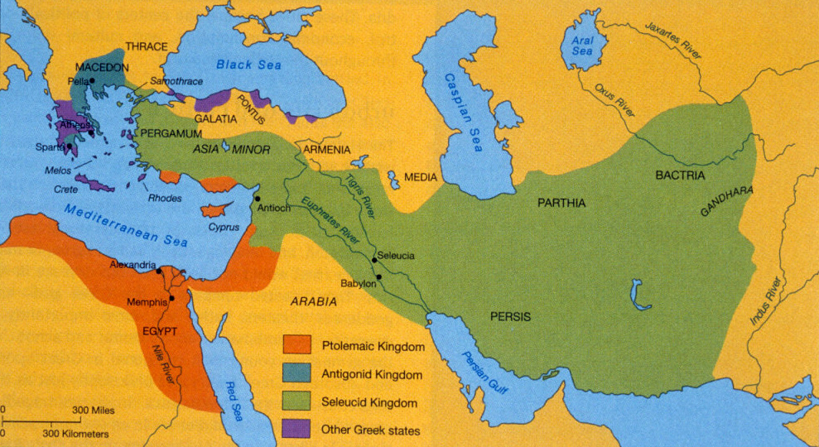

Slide 9
Greek Culture Spreads
The Hellenistic Kingdoms
Alexander wanted local cultures to mix with Greek- did not happen
Cities built in Greek style, ruled by Greeks, Greeks had best jobs
Had temples and agoras
People went to plays of Greek tragedies
People in cities spoke Greek (although native language spoken in rural areas)

Slide 10
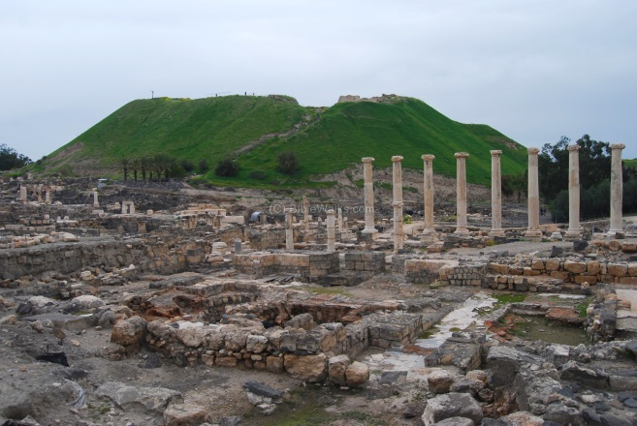
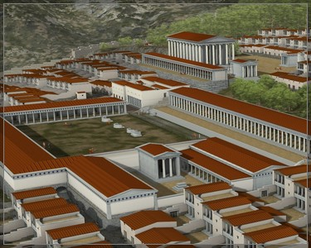
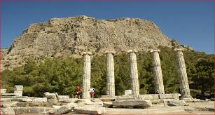

Slide 11
Greek Culture Spreads
Greek Culture in Egypt
Greatest Hellenistic city- Alexandria, Egypt
Founded in 322bc on Nile delta by Alexander
Became capital and trading center for Egypt
Two harbors- two lighthouses (350 feet)
Giant library- largest in the world- ½ million scrolls
Scholars from around the world went to study in Alexandria

Slide 12
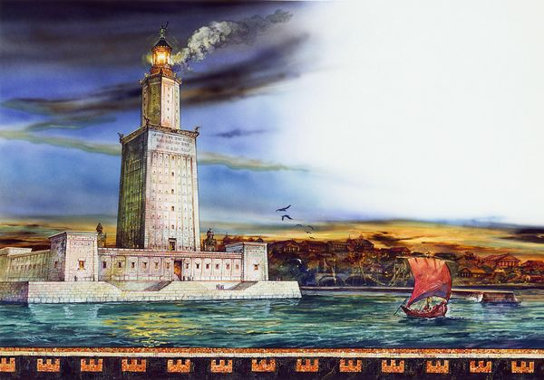
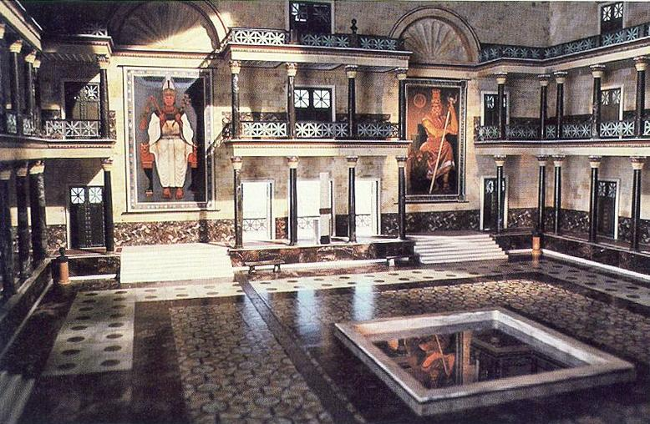

Slide 13
Math and Science
300bc- Alexandira- Euclid created geometry
Step by step proofs of math principles
Helped explain qualities of shapes
Still used today
Eratosthenes- calculated the distance around the Earth (yes, they knew it was round)
Very close to the correct size
Archimedes- used pulleys and levers to lift heavy objects
Even lifted a ship

Slide 14
