Slide 1
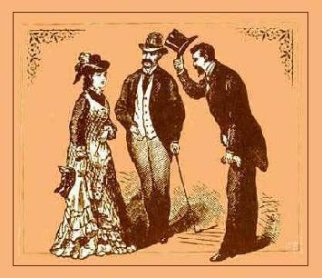
Life Skills
Unit 2: Etiquette

Slide 2
Table Manners
Chew with your mouth closed.
Avoid slurping, smacking, and blowing your nose.
Don’t use your utensils like a shovel and pitchfork.
Don’t pick your teeth at the table.
Use your napkin; keep it in your lap.
Wait until you finish chewing before you swallow or sip your drink (unless you’re choking)
Cut one piece of food at a time.
Try not to slouch, keep elbows off table while eating.
Ask for something to be passed, don’t reach.
Bring your drink to you, not yourself to your drink.
It’s not a race.

Slide 3
Table Manners
How do I remove something gross from my mouth?
What if I find a hair (or something else) in my food or drink?
What if you have to go potty?
What do I do when I am finished eating?

Slide 4
Cell Phones
You own your phone, it doesn’t own you.
Speak softly unless you’re alone.
Turn your phone off if it will be interrupting something.
Remember, keep it G-rated.
Don’t talk about personal problems in public unless it is an emergency.
Don’t make calls is a library, movie theater, church, OR AT THE DINNER TABLE! (includes texting!)
Private information can be forwarded, so don’t text it.
Don’t freak out if someone doesn’t respond to your text/call right away.

Slide 5
The Polite Passenger
If you are the passenger, remember you are not in control.
Don’t mess around with the controls—even to be funny.
If someone is giving you a ride, respect their rules---that includes curfew!
If someone is always giving you a lift or gives an inconvenient/long ride, offer gas money.
The car is not your garbage can.
Remember, warning the driver of a danger is okay, criticizing their driving is not.
If you are hot or cold, ask politely if the A/C can be changed.

Slide 6
Dating Do’s and Don’ts
The Bad Ask:
Huey: "Hey, Sue, what's going on?" Sue: "Not much. And you?" Huey: "Oh, the usual. Um, so, do you want to go to dinner or something sometime?" Sue: "Um... sure." (It's such a vague offer, it's hard for her to respond with much enthusiasm.) Huey: "Great! Where do you want to go?" Sue: "I don't know. Where do you like to eat?" (She's surprised that he doesn't even have a place in mind- and so, being unsure herself, she throws the question back at him.) Huey: Anything's good with me. What are you in the mood for?“
Huey blew it. He was too vague and show little interest in Sue.

Slide 7
Dating Do’s and Don’ts
The Good Ask:
Huey: "Hi, Sue. How's it going?" Sue: "I'm great. How 'bout you?" Huey: "I'm good, too. Listen, I was wondering if you'd like to go to dinner at that new Thai restaurant on Saturday. I know you've been wanting to try it ever since it opened.“
Huey did a great job! He:
-was polite
-was specific
-was considerate

Slide 8
Dating Do’s and Don’ts
When in doubt, just ask.
Boys:
Hold the door
Help her with her coat
Pay for the meal (if you asked)
Stand up to greet
Walk on the outside
Offer to carry something
Girls:
Don’t over indulge ($$$)
Unless he is being a total jerk, know that he is trying
Say thank you

