Slide 2
Big Government Definition
Big government is primarily defined by its size, measured by the number of employees or budget, either in absolute terms or relative to the overall national economy.
The size of government can also be reckoned by the number of "spheres of involvement”.
The concept can also be defined by the perceived role of government in society, the quality of services (that is, the impact of government effort), and the degree of democracy and societal representation.
Ties into the “loose interpretation” of the Constitution as shown by Alexander Hamilton, John Adams, and George Washington

Slide 3
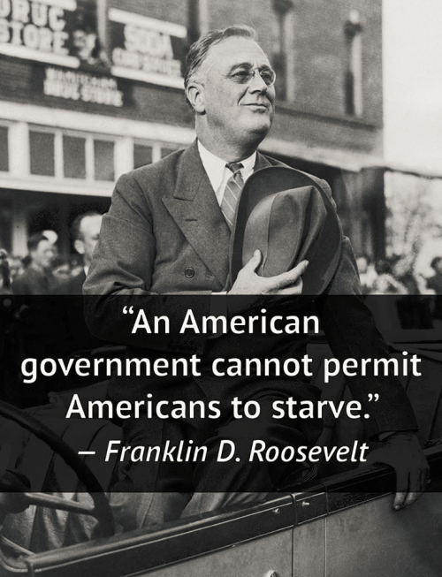

Slide 4
Big Government Examples
Historically:
The establishment of a National Bank under George Washington
The Freedman’s Bureau following the Civil War
The Tennessee Valley Authority under FDR (Part of the “New Deal”)
Modern Era:
Auto Industry Bailout 2008
Obamacare
Michelle Obama’s healthy school lunch program
Overall idea: higher taxes for more programs that benefit everyone (this includes a strong military)

Slide 5
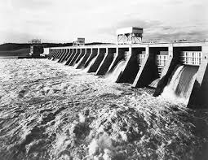
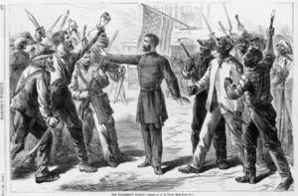
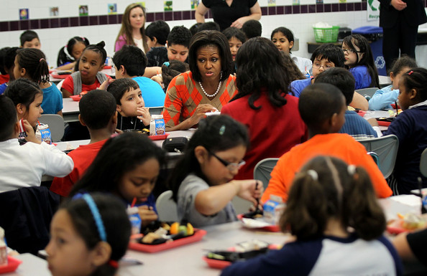

Slide 6
Small Government Definition
A Government that operates only within the frames of its Constitution
Has little influence on individual life- small “Sphere of influence”
The powers of the Federal government are strictly enumerated in the Constitution, all others are reserved for the States or the people. "The powers not delegated to the United States by the Constitution, nor prohibited by it to the States, are reserved to the States respectively, or to the people.“
AKA- “Strict Interpretation”

Slide 7
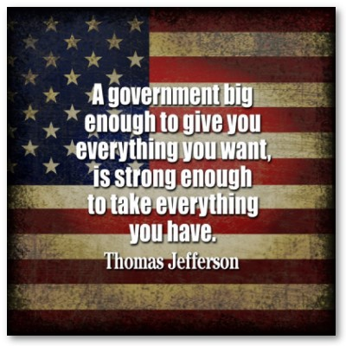

Slide 8
Small Government Examples
Historically:
“Laissez Faire” economic policy under Thomas Jefferson
The ending of the National Bank under Andrew Jackson
Tax cuts and end of many government programs under Ronald Reagan
Modern Era:
Budget Control Act of 2011
Overall idea- fewer taxes, lower government spending, few government programs outside of powers given in Constitution (education, healthcare, etc)
This gets complicated- preamble to Constitution defines the purpose (1 of 5) to “promote the general welfare”

Slide 9
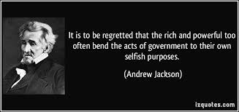
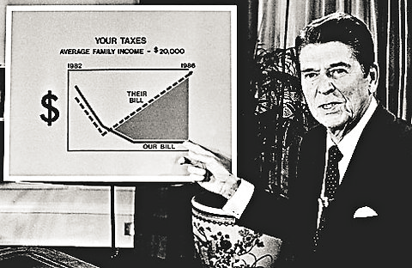
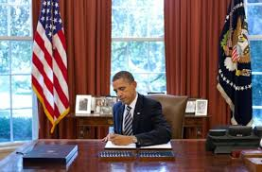

Slide 10
Common Arguments for Big Government
Big government can help the individual, was created by, of, and for the people, and is made up of individuals working to meet collective needs
Strong citizen-driven governments binds communities
Small governments lead to less healthy societies
Government is the leading agent of change and progress
Big government programs come from citizen demand
Big government promotes economic growth- especially with small businesses
More taxes help the economy grow (see 1990’s)
European-style big governments have more stable societies

Slide 11
Common Arguments for Small Governments
Small government encourages self-reliance
Big government hurts the people it is trying to help
Not all community needs are the responsibility of the government
The government is not a charity
Big government grows even bigger; bureaucrats yearn for more power to advance careers
Big government is expensive
Small governments can not hide wasteful spending
Big government programs have unintended results
Small government leads to higher income
Big government leans to special interests (big business, big tobacco, big pharma, etc)
Big government spending helps the poor less than tax cuts

Slide 12
What are we going to do?
Please read up on the pros and cons of big vs. small government. This debate began in the 1780's and still continues today. There is a link on my website to some of the common arguments. Each pro/con gives a quick summary. You can click on the title for further information in most cases. We will have a structured debate in class next Thursday. On Monday you will be asked to choose a side. With your members of your group, you will discuss and formulate arguments that back up your opinion of whether the United States should operate a big or a small government. Each side will be given alternating opportunities to make a case and then respond to the argument of the other side.
WARNING FROM THE WEISE: When doing research, be very conscious about bias. There are TONS of websites from either very liberal or very conservative viewpoints. For your own opinion!

